Slide 1
HTML & Css Day2
ENG. Nawal Zaki Abdelhadi
iTi Staff

Slide 2

HTML IFrames
1

Slide 3

HTML Elements
An iframe is used to display a web page within a web page.
An HTML iframe is defined with the <iframe> tag:
<iframe src="URL"></iframe>
The src attribute specifies the URL (web address) of the inline frame page.
Use the height and width attributes to specify the size of the iframe.
<iframe src="demo_iframe.htm" height="200" width="300"></iframe>
An iframe can be used as the target frame for a link.

Slide 4
HTML Elements
<iframe src="demo_iframe.htm" name="iframe_a"></iframe>
<p>
<a href="http://www.w3schools.com" target="iframe_a"> W3Schools.com </a>
</p>
Let’s Try it …

Slide 5

HTML Tables
2

Slide 6
Table Tags
<table> tag to define Table structure.
<table>
<tr>
<th> Name </th>
<th> Phone </th>
</tr>
<tr>
<td> Ahmed </td>
<td> 01007878583 </td>
</tr>
</table>
<tr> tag to define row
inside the table
<th> tag to define the header cell and make it centered and
bold.
<td> define columns inside each row, and this tag contains cell data.

Slide 7
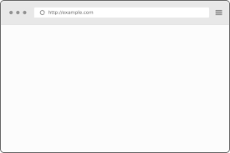
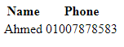
Table Tags
Let’s Try it …

Slide 8
Table Tags
Table with Caption
<table>
<caption align="top"><b>Table Caption</b></caption>
<tr>
<td> Name </td>
<td> Phone </td>
</tr>
<tr>
<td> &nbsp; </td>
<td> 0107897987 </td>
</tr>
</table>

Slide 9
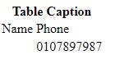
Table Tags
Let’s Try it …

Slide 10
Colspan and Rowspan attributes
Colspaned Cell:
<td colspan="2">&nbsp;</td>

Slide 11
Colspan and Rowspan attributes
Rowspaned Cell:
<td rowspan="2">&nbsp;</td>

Slide 12
Colspan and Rowspan attributes
Rowspanned and Colspanned cell:
<td colspan="2" rowspan="2">&nbsp;</td>

Slide 13

Self Study
<colgroup>
<col>
<thead>
<tbody>
<tfoot>

Slide 14
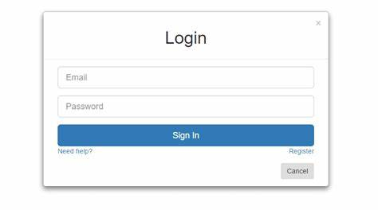
HTML Forms
3

Slide 15
Forms …
<form action=“” method=“”>
<! – any tags for forms -- >
</form>
<form> to define form
Form has two important
Attributes action to define
Address and method
Post or get

Slide 16
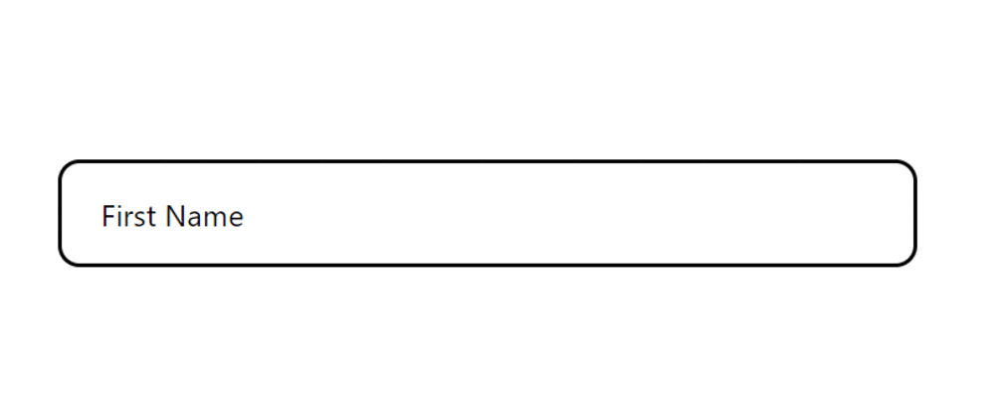
Text Field …
<input type="text" size="25" value="Enter your name here!">
Attributes :
1) Size 2) Maxlength
3) Name 4) Value
5) Align 6) Tabindex

Slide 17
Hidden Field…
<input type=“hidden" “ value=“”>
A control that is not displayed but whose value is
submitted to the server.
Attributes :
1) Name 2) Value

Slide 18
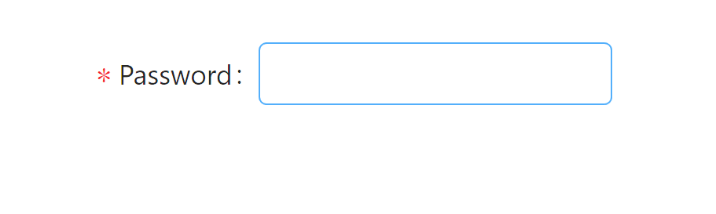
Password Field…
Enter Password : <input type="password" size="25">
Attributes :
1) Size 2) Maxlength
3) Name 4) Value
5) Align 6) Tabindex

Slide 19
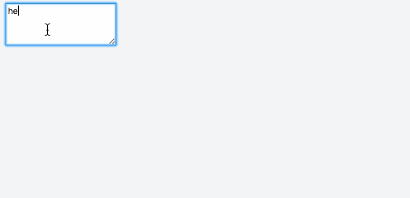
Text Area…
<textarea cols="40" rows="5" name="myname">
Now we are inside the area - which is nice.
</textarea>
Attributes :
1) Rows 2) Cols
3) Name 4) Tabindex

Slide 20
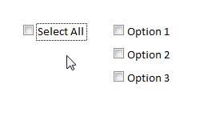
Check Box…
<input type="checkbox" name="option1" value=“1">
choice 1
<br>
<input type="checkbox" name="option2" value=“2“ checked>
choice 2
<br>
Attributes :
1) Name 2) Value
3) Align 3) Tabindex
4) Checked

Slide 21
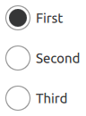
Radio button…
<input type="radio" name="group1" value=“f“ checked >
First
<input type="radio" name="group1" value=“s" >
Second
<input type="radio" name="group1" value=“t" >
Third
Attributes :
1) Name 2) Value
3) Align 3) Tabindex
4) Checked

Slide 22
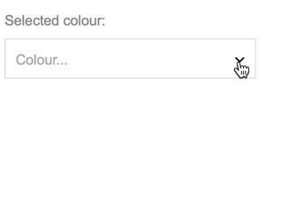
Drop-down menu…
<select name=“favDrink”>
<option value=“M”>Milk</option>
<option value=“C”> Coffee</option>
<option value=“T”> Tea</option>
</select>
Attributes :
Select
1) Name 2) Size 3) Multiple
Option
1) Selected 2)Value

Slide 23
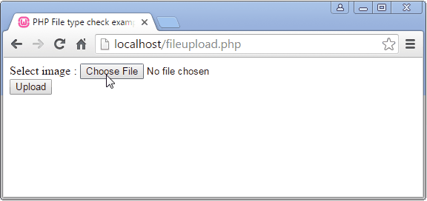
File …
<input type="file“ name="myFile" >
Allow user to upload file

Slide 24
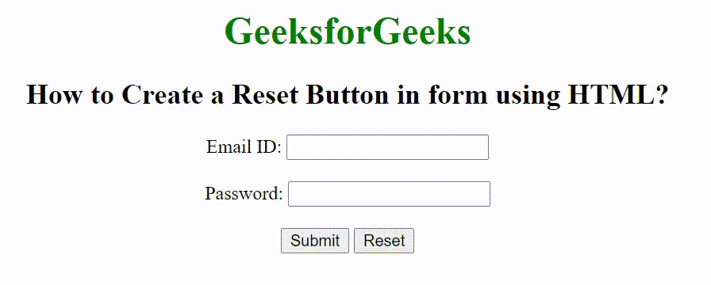
Submit button / Reset button …
<input type="submit" value=“Submit">
<input type=“reset" value=“Rest">
Attributes :
Select
1) Name 2) Value
3) Align 4) Tabindex

Slide 25

Image button …
<input type="image" src="rainbow.gif" name="image"
width="60" height="60">
Image buttons have the same effect as submit buttons.
Attributes :
1) Name 2) Src 3)Align
4) Border 5) Width 6)Height
7) Tabindex

Slide 26

Button …
<input type=“button" value=“Click me!“ />
<! – OR -- >
<button name=“b1”> click me </button>
Will act as a submit button if it’s inside a form.

Slide 27
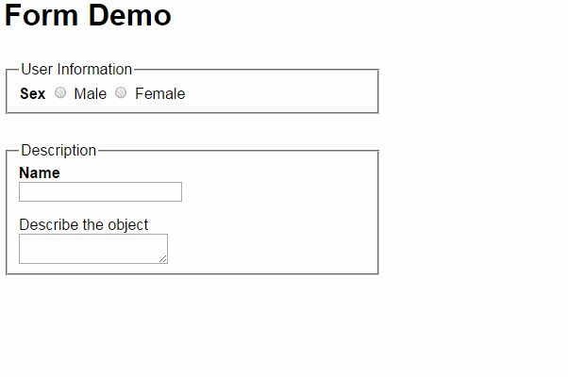
Form Fieldset …
<form method="post" action=“main.html">
<fieldset>
<legend>login</legend>
Name:<input type="text" id="Name" />
Password:<input type=“password" id=“Pswd" />
</fieldset>
</form>
<fieldset> is used to enclose a group of related form fields
together.
The <legend> is the fieldset's title.

Slide 28
Form Labels …
<form>
<label for="fn">First Name</label>
<input type="text" id="fn" />
</form>
Form labels are used to associate an explanatory text to a
form field using the field's ID.
Clicking on a label focuses its associated field (checkboxes
are toggled, radio buttons are checked)

Slide 29
Tabindex and Access Key …
<form>
<label for="fn">First Name</label>
<input type="text" id="fn" tabindex=“1” accesskey="n"/>
</form>
tabindex attribute define a sequence that users follow when they use the Tab key to navigate through a page.
access keys allow easier navigation by assigning a keyboard shortcut to a link. It can be used on any HTML element.

Slide 30

New Form Elements in HTML5
4

Slide 31
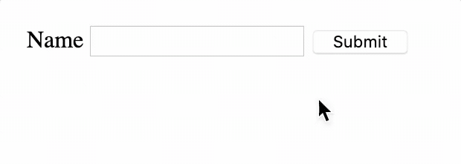
Required …
<form>
<input type="text" required/>
</form>
Required: We also have required attribute to mark this field as mandatory.

Slide 32
Multiple and Pattern …
<form>
<input type="text" multiple/>
</form>
Multiple: allows the user to enter multiple email addresses.
<form>
<input type="text" pattern=“[0-9][A-Z]{3}”/>
</form>
Pattern: custom validate,
A part number is a digit
followed by three uppercase
letters.

Slide 33
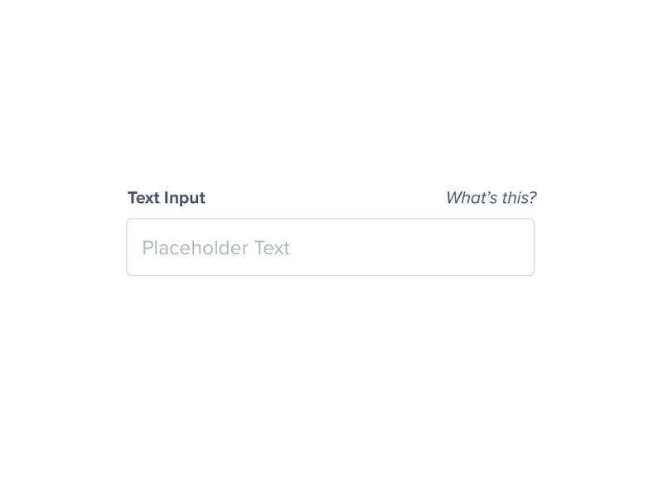
Placeholder …
<form>
<input type="text" placeholder=“Enter Your Name” >
</form>
Placeholder: add a hint inside the text-field, but where the hint
automatically disappears when clicking inside it.

Slide 34
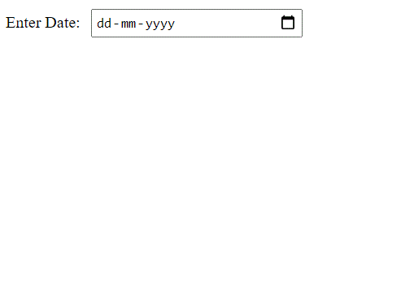
Dates and Times …
<input type="datetime“>
<input type="datetime-local">
<input type=“date“>
<input type=“month“>
<input type=“week“>

Slide 35
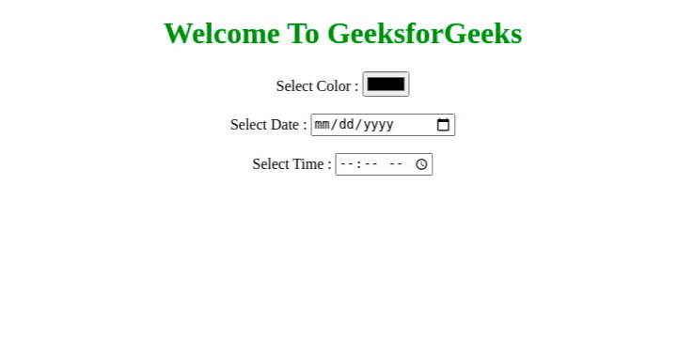
Dates and Times …
<input type="time“>

Slide 36

Search …
<input type=“search“>

Slide 37
Color …
<input type=“color”>

Slide 38
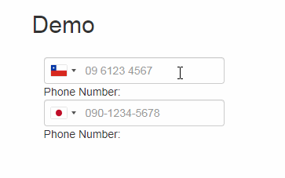
Telephone …
<input type=“tel”>

Slide 39
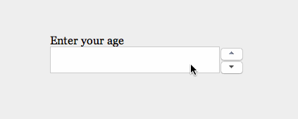
Number …
<input type=“number”>

Slide 40
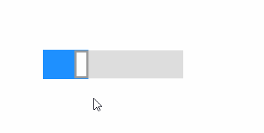
Range …
<input type=“range”>

Slide 41
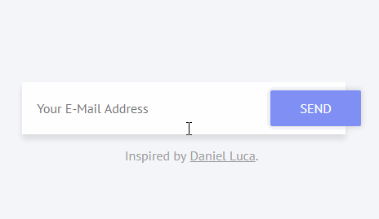
Email …
<input type=“email”>
<input type=“url”>

Slide 42
Form Attributes …
New attributes for <form>:
1) autocomplete 2) novalidate
New attributes for <input>:
1) Autocomplete 2) autofocus 3) form 4) formaction
5) formenctype 6) formmethod 7) formnovalidate
8) formtarget 9) height and width 10) list
11) min and max 12) multiple 13)pattern (regexp)
14) placeholder 15) required 16) step

Slide 43


